Slide 1

My Linear Relationships Interactive Notebook
Name
Class
Teacher
Semester 2
Term 4
1

Slide 2

Interactive Notebooks!
Cover Page
Contents Page
Glossary
24/7/30
EQ
Questions
Notes
Summaries
Work page
Presentation!!!
Your book, your responsibility!

Slide 3
Contents
Glossary or Formula Page
Page
Date
Description
For example
Linear: ___________
Origin: ___________
Coordinates: __________
2
3

Slide 4

24
7
30
Tasks
24
7
30
Essential Question
Complete the tasks on this side (left) of your page
You should be ticking these off!
Questions
Notes
Write your notes on this side (right) of your page
Summary
Have YOU been doing your summaries?
Your book, your responsibility!

Slide 5
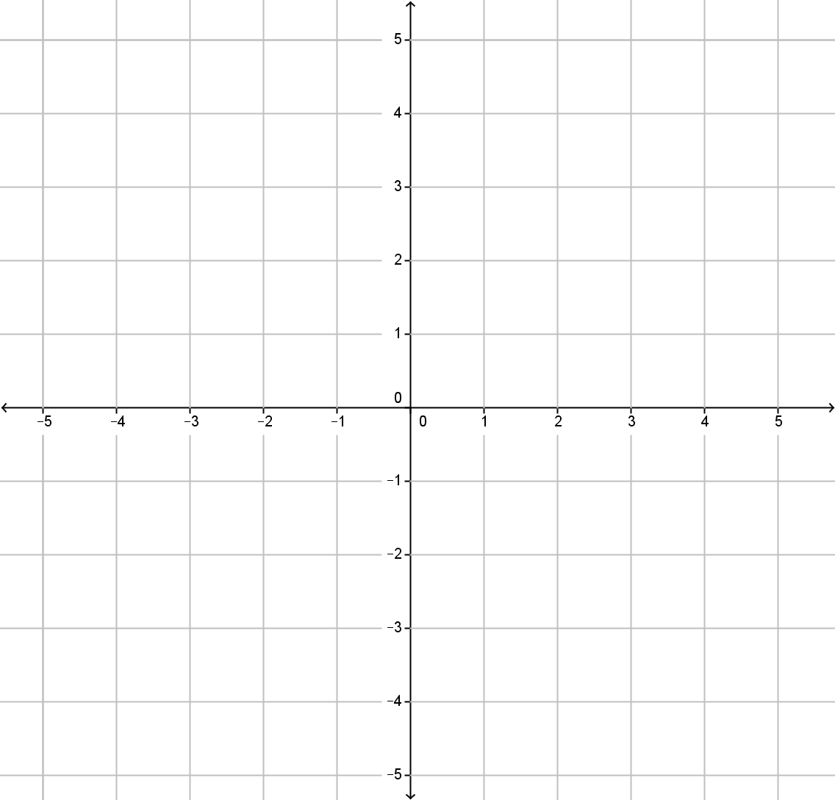
From last lesson
Consider the equation y = 2x + 1
Create a table using x values from -2 to 2
Draw a graph using this table
y = 2x + 1
x | -2 | -1 | 0 | 1 | 2
y = 2x + 1
y | -3 | -1 | 1 | 3 | 5

Slide 6
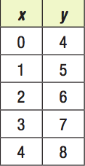
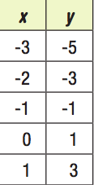
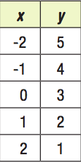
Think – Pair - Share
Each of the following tables describes a linear relationship between x and y
1.
2.
3.
Find a partner, and discuss the relationship between x and y, using mathematical language (i.e. – as x increases, y…..)
Write a rule for each table
As a class, discuss your strategy for writing each rule. What patterns did you notice and how did they help determine the rule?

Slide 7
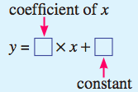
24
7
30
Date
Linear Relationships
EQ – How do you find a rule from a table of values?
A rule must be true for every pair of coordinates (x,y) in a table or graph. Rules are written in the following form:
The coefficient of x will be the increase or decrease in y as x increases by 1.
If y increases, the coefficient is positive.
If y decreases, the coefficient is negative.
The constant will be the value of y when x = 0

Slide 8
24
7
30
Date
Linear Relationships
EQ – How do you find a rule from a table of values?
Example
Write a rule from the following table:
x | -2 | -1 | 0 | 1 | 2
y | -1 | 1 | 3 | 5 | 7
+2
+2
+2
+2
2
3
As x increases by 1, y increases by 2, so the coefficient is 2.
When x = 0, y = 3, so the constant is 3.
Therefore the rule is y = 2x + 3

Slide 9
24
7
30
Date
Linear Relationships
EQ – How do you find a rule from a table of values?
Example
Write a rule from the following table:
x | -2 | -1 | 0 | 1 | 2
y | 1 | 0 | -1 | -2 | -3
-1
-1
-1
-1
-1
-1
This time, as x increases by 1, y decreases by 1, so the coefficient is -1.
When x = 0, y = -1, so the constant is -1.
Therefore the rule is y = -x - 1

Slide 10

Do you understand?
Notes:
Check for Understanding

Slide 11
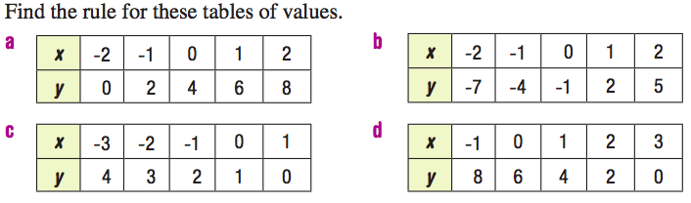
Your turn

Slide 12
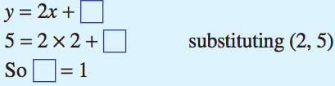
24
7
30
Date
Linear Relationships
EQ – How do you find a rule from a table of values?
What happens when the value of y when x = 0 isn’t given!?!?
x | 2 | 3 | 4 | 5
y | 5 | 7 | 9 | 11
+2
+2
+2
2
We need to substitute another pair of coordinates to find the constant. We’ll use the first pair, (2,5).

Slide 13
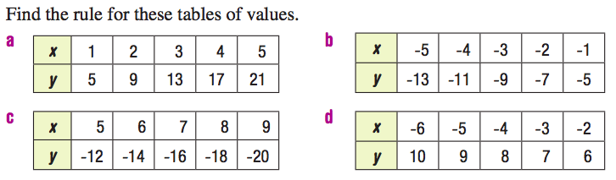
Your turn

Slide 14
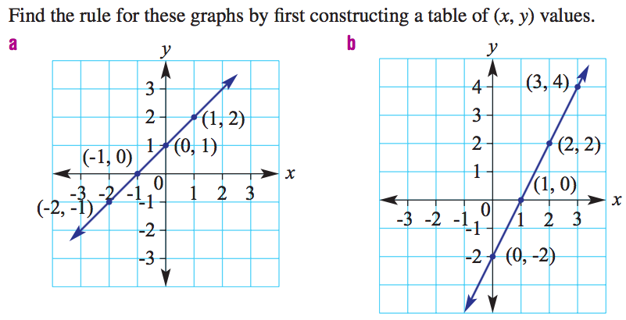
Further Application

